Slide 1

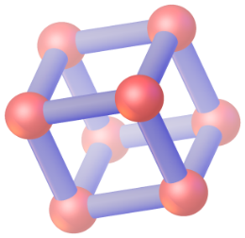
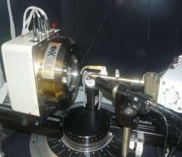
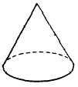
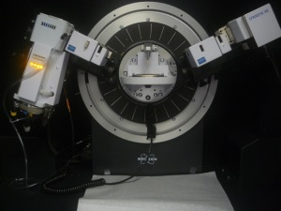
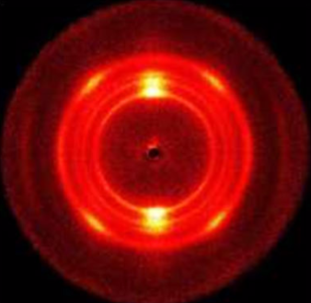
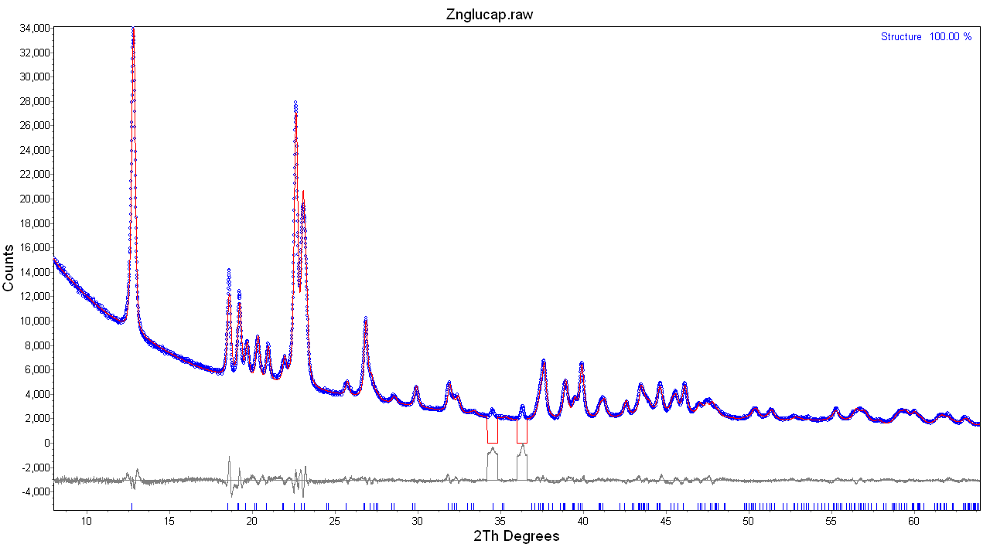
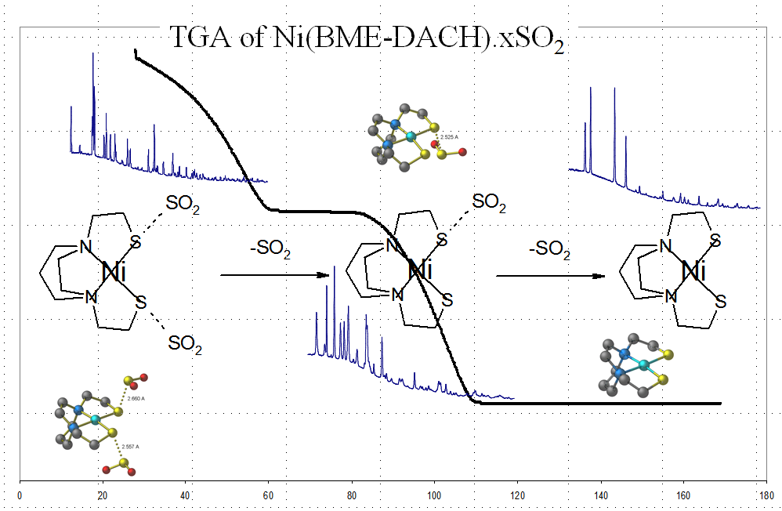
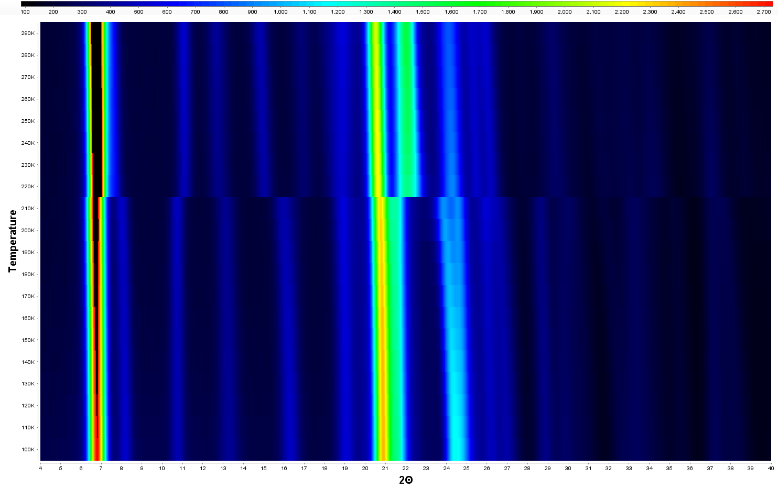
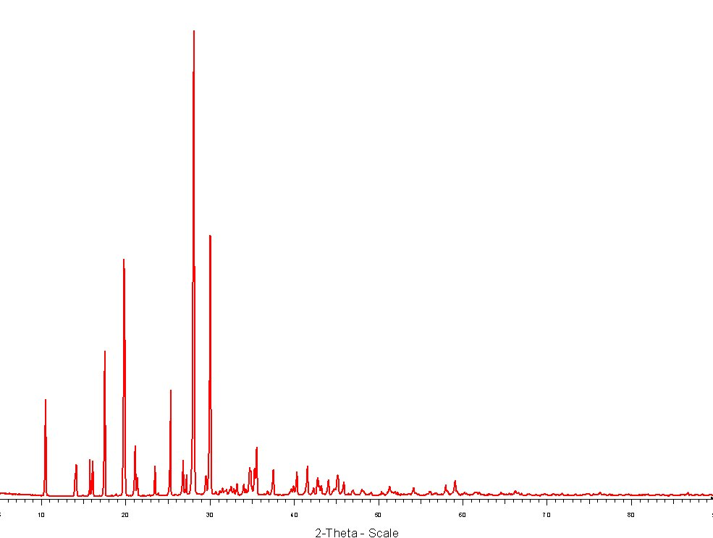
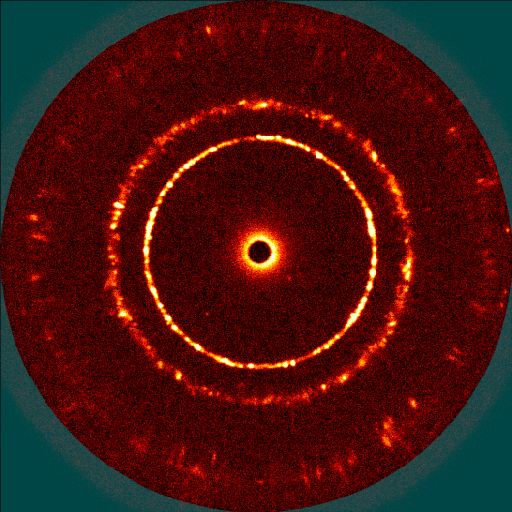



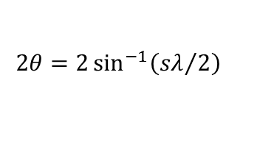

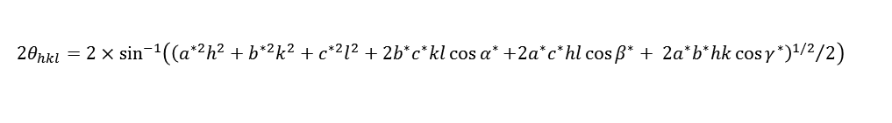


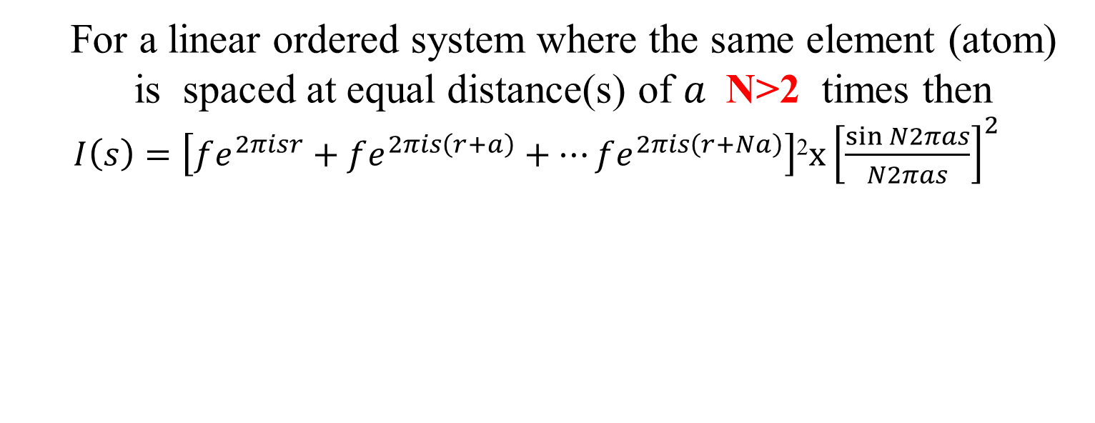

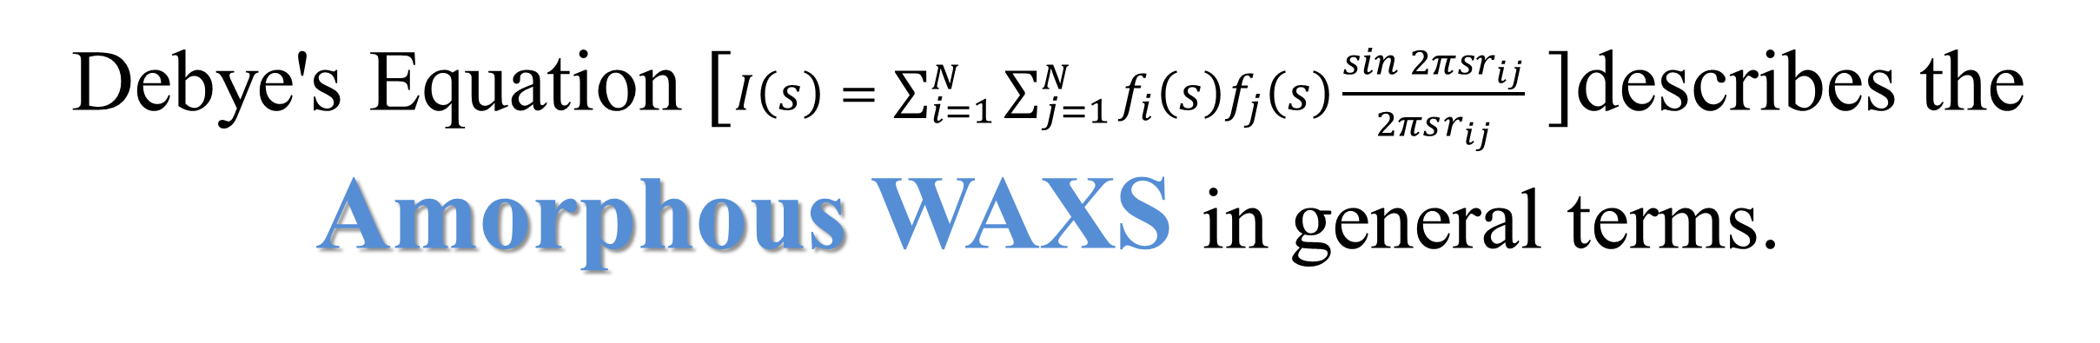
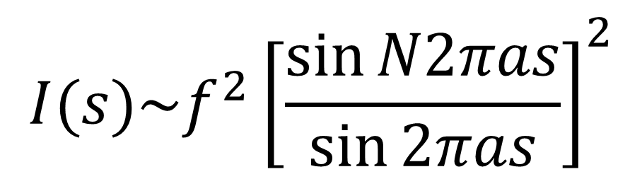
CHEMISTRY
TEXAS A&M UNIVERSITY
Wide Angle Scattering (WAXS) (Powder Diffraction)
How do we do
XRDLab
TAMU
The Solid State
Data Collection
cum videbimus lumen
Debye's Equation [$I\left(s\right)=\sum_{i=1}^{N}{\sum_{j=1}^{N}{f_{i}{\left(s\right)f}_{j}\left(s\right)\frac{\sin{2π{sr}_{ij}}}{2πsr_{ij}}}}$ ]describes the
Amorphous WAXS in general terms.
X-rays diverge from the source (A) strike the specimen (B) and converge back to the detector (C) .
Source (A)
Detector (C)
A
For a VERY simple system (all orientations are present) where the average contact distances are near 1.5, 2.5 and 5 Å we can predict the scattered pattern given below. (λ=1.54Å). Intensity decreases (exponentially) as 2θ increases
B
C
Specimen (B)
2θ
$$I\left(2θ\right)\sim {\left[f\left(s\right)\right]}^{2}\sim {\left[ae^{−bs^{2}}+c\right]}^{2}$$
$$2θ=2\sin^{−1}\left({sλ}/2\right)$$
Transmission with Area detection.
The area (2D) detector is positioned behind the sample. X-rays travel; through the sample and are collected at the detector
Crystalline Semi crystalline Amorphous
Long range order short range order only
$$I(2θ)$$
5Å
2.5Å
BRAGG BRENTANO :The detector is positioned at 2θ angle to collect the data. The number of X-rays counted by the detector is proportional to the intensity (I) of the scattered X-ray
“For most crystallographers it is long-range order that sets crystals apart from glasses and amorphous solids. But condensed-matter physicists have recognized that there is a structural continuum between ideal crystals and amorphous solids.” . Gautam Desiraju : Nature 2013
1.5Å
$$2θ$$
Fiber Diffraction
  For a linear ordered system where the same element (atom) is spaced at equal distance(s) of $a$N>2 times then
$I\left(s\right)=\left[fe^{2πisr}+fe^{2πis\left(r+a\right)}+…fe^{2πis\left(r+Na\right)}\right]$²$x{\left[\frac{\sin{N2πas}}{N2πas}\right]}^{2}$
Applications
Interaction of X-ray radiation with solids
Crystalline
Collision of the X-ray photon with a charged particle causes the component of the particle to oscillate with the same frequency.
The oscillating particle returns to the resting state by emitting a photon that travels outward.
given : ${ \left[\frac{\sin{N2πas}}{N2πas}\right]}^{2}\sim \frac{1}{N^{2}}{\left[\frac{\sin{N2πas}}{\sin{2πas}}\right]}^{2}$ then
$$I(s)\sim f^{2}{\left[\frac{\sin{N2πas}}{\sin{2πas}}\right]}^{2}$$
Semi crystalline
Polymorphs
The Math
Debye’s Equation describes the interaction of radiation between two identical “atoms” i and j separated by the distance r_{ij}
As N increases the peak sharpens until N>1000 atoms at which time you reach the line width of the instrument.
Zinc Glutamate
Spacegroup P2/c
a (Å) 13.8847(1)
b (Å) 4.7879(3)
c (Å) 9.2663(6)
beta (°) 90.506(3)
Amorphous
$I\left(s\right)=\sum_{i=1}^{2}{\sum_{j=1}^{2}{f_{i}{\left(s\right)f}_{j}\left(s\right)\frac{\sin{2π{sr}_{ij}}}{2πsr_{ij}}}}$ (1)
Where $s=2{\sin{θ}}/λ$ and $f\left(s\right)$=$\sum{ae^{−bs^{2}}+c}$
For a diatomic molecule of the same element the 1st maxima (s >0) for Debye’s equation (2nd derivative of 1) will be ~$r_{m}s_{m}=\frac{7.7}{2π}=1.225$ given
s_{m} $={2\sin{θ_{m}}}/λ$ then :
$Kλ=2r_{m}\sin{θ_{m}}$ K = 1.23
For a 3D ordered system (Crystalline)
$F\left(s\right)=\sum_{1}^{N}{f_{n}\left(s\right)e^{2πisr} }$ $r=xa+yb+zc$ (unit cell as vectors)
$F\left(s\right)=\sum_{1}^{N}{f_{n}\left(s\right)e^{2πis\left(xa+yb+zc\right)}}$ Given $s∙a=h, s∙b=k,s∙c=l$
$F\left(s\right)=\sum_{1}^{N}{f_{n}\left(s\right)e^{2πi\left(hx+ky+lz\right)}}$ and $I\left(s\right)≈{\left|F\left(s\right)\right|}^{2}$
For the 3D ordered systems $I\left(s\right)$ will have maxima at discrete positions $hx+ky+lz$ ⇒ 2θ_{hkl}
Structure Determination from Powder Data and Rietveld Refinement
$$a,b,c are \text{the} \text{Cromer}\text{−}\text{Mann} \text{coefficients} \text{for} \text{a} \text{given} \text{element}$$
Phase Analysis
$$2θ_{hkl}=2×\sin^{−1}\left({{\left(a^{∗2}h^{2}+b^{∗2}k^{2}+c^{∗2}l^{2}+2b^{∗}c^{∗}kl\cos{α^{∗}}{+2a^{∗}c^{∗}hl\cos{β^{∗}}+} 2a^{∗}b^{∗}hk\cos{γ^{∗}}\right)}^{1/2}}/2\right)$$
h=2,k=1,l=2
h=1,k=1,l=0
I(2,1,2) ≈ F(2,1,2)² [atoms (e⁻) in 2,1,2 plane]
Paraffin
1.1.2 2018 TAMU
2θ
Qualitative Analysis

