Slide 1
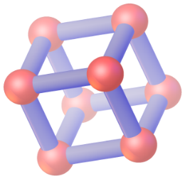
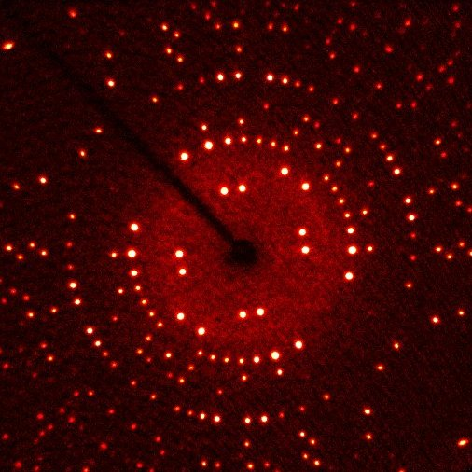
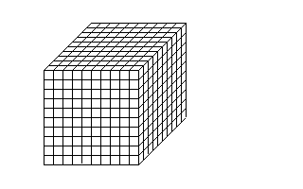
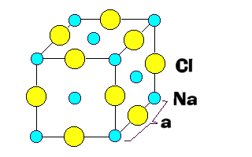
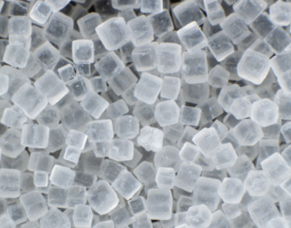
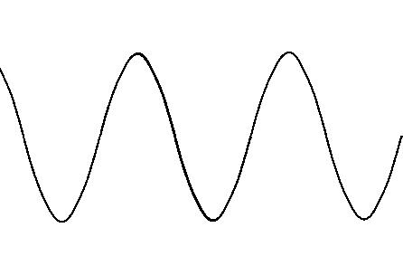
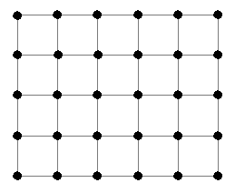
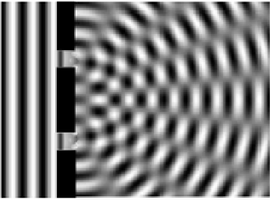
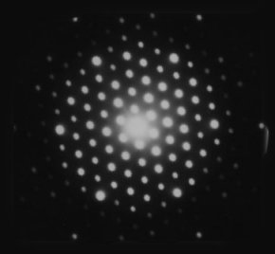
CHEMISTRY
TEXAS A&M UNIVERSITY
XRDLab
TAMU
Crystallography
How do you do?
From Diffraction to structure….
Normally one would use a microscope to view small objects. If we use a light microscope we cannot look at objects smaller than the wavelength of light which is about 10 ⁻⁶ m. Since the atom has dimensions of about 10⁻¹⁰ m we cannot image an atom with a photon of light. X-rays, on the other hand, have a wavelength of about 10 ⁻¹⁰ m and are suitable for imaging objects at the atomic scale but cannot be lensed, so we must do what a lens would do only with X-rays, math and modeling ….
cum videbimus lumen
Structure from crystals
There are roughly 50 000 000 000 000 000 000 atoms of Na and Cl in a single crystal of salt. To describe the structure of salt at the atomic level we would need to describe roughly 5 x 10¹⁹ atomic positions!! BUT there is an easier way. A crystal has long range three-dimensional order. If we could describe a small portion of that order (unit cell) we could then use SYMMETRY to describe the whole crystal! AND that is what we do.
X-ray Diffraction is ..
X-rays scatter off of electrons, in a process of absorption and re-admission. Diffraction is the accumulative result of the X-ray scattering of a group of electrons. For an incident X-ray photon of monochromatic wavelength, coherent waves are produced at an angle of theta (2-θ with respect to the incident X-ray). if the electron groups interact with the X-ray and are spaced at a distance d then the interaction is described by Bragg's law :
nλ =2dsin(θ).
The intensity of the scattered X-ray is proportional to the number of electrons that the X-ray scatters from.
Collect Data and Integrate
Resolution limit
$d_{min}=$ $λ/{\left(2\sin{θ_{max}}\right)}$
Diffractometer
Describing Order in Space….
$${θ }_{max}$$
Cool crystal to hinder atom vibration
Detector
Cold Stream
$$d_{2}^{∗}$$
A crystal is a solid material whose constituent atoms (molecules and ions) are arranged in an orderly repeating pattern extending in all three spatial dimensions.
$${θ }_{min}$$
X-ray source
$$d_{3}^{∗}$$
Crystal
$$d_{1}^{∗}$$
b
Two parallel waves show constructive interference when they are in phase i.e. when n₁l = n₂λ (where n₁ and n₂ are integers)
Position crystal in space with mechanical circles
$d_{hkl}^{∗}$= ${2\sin{θ_{hkl}}}/λ$
Integrate
Crystal of Salt
$d_{hkl}^{∗}=\left(1/{d_{hkl}}\right)$→ where the atoms are
$I\left(hkl\right)$ → what the atoms are
$$d_{hkl}^{∗}$$
$$I(hkl)$$
α
γ
a
Convert $I(hkl)$to a Wave
β
$${\left|F_{hkl}\right|}_{obs}=\sqrt{kI_{hkl}}$$
c
Path length of wave 1
λ = 2l
$$ρ\left(xyz\right)=\sum_{h}{\sum_{k}{\sum_{l}{{\left|F_{hkl}\right|}_{obs}\cos{2π\left(hx+ky+lz−α′\right)}}}}$$
[phase angle]
c
unit cell
λ
l
l
$$\tan^{−1}\left(\frac{\sum_{i}{f_{i}\sin{2π\left(hx_{i}+ky_{i}+lz_{i}\right)}}}{\sum_{i}{f_{i}\cos{2π\left(hx_{i}+ky_{i}+lz_{i}\right)}}}\right)=α_{hkl}$$
The unit cell is a parallepiped that describes the smallest unique volume of the crystal (cell parameter : a, b, c, α, β, γ )
There are 230 ways (space groups) to arrange objects in the unit cell that brings a periodic arrangement of the objects back to their original positions.
[electron density map with grid (x, y, z)]
Path length of wave 2
[positions of the atoms (i) are ( x_{i}, y_{i}, z_{i} )
and$f_{i}{=f}_{calc,i}\exp\left({−2π^{2}Ud}^{∗2}\right)$ where
U are displacement parameters]
[start with random phase angles or atomic positions and deduce initial phase angles]
Waves diffract off of planes (of electrons)
ρ(xyz) = Electron Density Map (wave)
1(c)
Wave 1
The diffraction angle relative to the incident beam is θ + θ or 2θ
The Miller Indices (h,k,l) (Grid)
are the reciprocal of the intercepts of imaginary planes that dissect the unit cell with the crystallographic indices : h , k, l.
[(hkl)]
(222) planes
Wave 2
z
Model : x_{i} y_{i} z_{i} U_{i}
l=2
½
h=2
½
1(b)
d_{hkl}
θ
θ
Make a model to approximately fit the wave
½
k=2
The planes are describe by Miller indices h,k,l
θ
d
When l+l = nλ then the two waves are in phase
1(a)
Crystals and Photons…
l
l
Ordered pinholes
Electrons in atoms scatter high energy photons (particles)
Ordered electrons (atoms) scatter orderly
Crystals have long-range 3D ordered atoms
The distance between the planes is d_{hkl}
θ
d
Bragg’s Law
l/d = sinθ
l=dsinθ
(since nλ= l+l then)
nλ=2l=2dsinθ
therefore..
d*=1/d=2sinθ/ nλ
x
y
Move atom (+ y direction).
$$b$$
$$a$$
l
Refine the model with non-linear least squares to fit the wave
$$d_{hkl}$$
Orderly Scattering (diffraction)
Modify the parameters (p) or model and repeat
p =p_{i} +Δp
$$c$$
d* and θ can be described by the Miller Indices and cell parameters
Model Fits?
1D diffraction pattern
${ {\left({2\sin{θ}}/λ\right)}^{2}= \left(1/{d_{hkl}}\right)}^{2}=d_{hkl}^{∗2}=a^{∗2}h^{2}+b^{∗2}k^{2}+c^{∗2}l^{2}+2b^{∗}c^{∗}kl\cos{α^{∗}}{+2a^{∗}c^{∗}hl\cos{β^{∗}}+}$ $2a^{∗}b^{∗}hk\cos{γ^{∗}}$
no
3D diffraction pattern
Model Fits the wave !!!
Report x_{i} y_{i} z_{i} , U_{i,} cell parameters, spacegroup etc.
yes
Rev. 1.1.1 2017 TAMU
2D diffraction pattern
Where d* = reciprocal of d and a* is the recip. of a and b* is the recip. of b etc…

